Slide 1


Java Exception Handling
Sydubabu Vasantha
July 10, 2017

Slide 2
Agenda
Overview of Exception and Error
Hierarchy of Exception classes
Types of Exceptions
Catching Exceptions
Custom Exceptions
Common Mistakes Java Developers make when Handling Exceptions

Slide 3
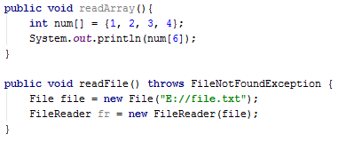
Overview Of Exception
An exception is a problem that arises during the execution of a program. When an Exception occurs the normal flow of the program is disrupted and the program/Application terminates abnormally, which is not recommended, therefore, these exceptions are to be handled.
An exception can occur for many different reasons. Following are some scenarios where an exception occurs.
A file that needs to be opened cannot be found.
A user has entered an invalid data.

Slide 4
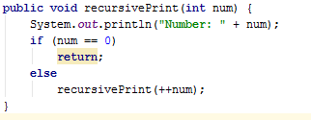
Overview of Error
These are not exceptions at all, but problems that arise beyond the control of the user or the programmer.
Errors are typically ignored in your code because you can rarely do anything about an error. For example, if a stack overflow occurs, an error will arise.
They are also ignored at the time of compilation.

Slide 5
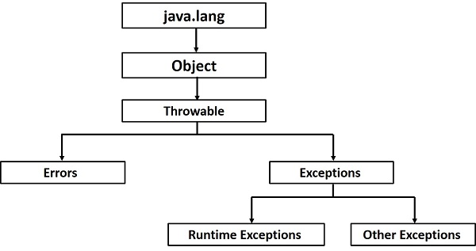
Hierarchy of Exception Classes
Throwable: Superclass of all errors and exceptions in the Java language.
Only objects that are instances of this class (or one of its subclasses) are thrown by the Java Virtual Machine or can be thrown by the Java throw statement.
Similarly, only this class or one of its subclasses can be the argument type in a catch clause.
Exception: The class Exception and its subclasses are a form of Throwable that indicates conditions that a reasonable application might want to catch.
Error:An Error is a subclass of Throwable that indicates serious problems that a reasonable application should not try to catch.

Slide 6
Throwable class
Important methods of throwable class.
getCause():Returns the cause of this throwable or null if the cause is nonexistent or unknown.
getMessage():Returns the detail message string of this throwable.
printStackTrace():Prints this throwable and its backtrace to the standard error stream.

Slide 7
Types of Exceptions
There are mainly two types of exceptions: checked and unchecked where error is considered as unchecked exception. The sun microsystem says there are three types of exceptions
Checked exceptions
Unchecked exceptions
Error

Slide 8
Checked Exceptions
A checked exception is an exception that occurs at the compile time, these are also called as compile time exceptions. These exceptions cannot simply be ignored at the time of compilation, the programmer should take care of (handle) these exceptions.
IOException
SQLException
DataAccessException
Use checked exceptions for conditions from which the caller can reasonably be expected to recover.

Slide 9
Unchecked Exceptions
An unchecked exception is an exception that occurs at the time of execution. These are also called as Runtime Exceptions. These include programming bugs, such as logic errors or improper use of an API. Runtime exceptions are ignored at the time of compilation.
NullPointerException
ArithmeticException
ArrayIndexOutOfBoundsException
Use runtime exceptions to indicate programming errors

Slide 10
Catching Exceptions
There are 5 keywords used in java exception handling.
try
catch
finally
throw
throws

Slide 11
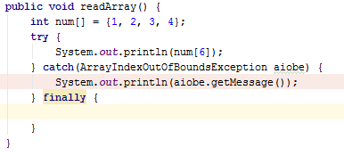
Try-catch block
A method catches an exception using a combination of the try and catch keywords.
A try/catch block is placed around the code that might generate an exception.
Code within a try/catch block is referred to as protected code.
The code which is prone to exceptions is placed in the try block.
Every try block should be immediately followed either by a catch block or finally block.

Slide 12
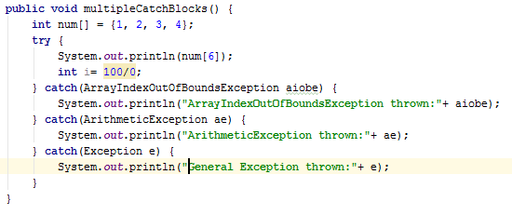
Multiple Catch Blocks
A try block can be followed by multiple catch blocks.
We can have any number of catch blocks after a single try.
If the data type of the exception thrown matches ExceptionType1, it gets caught there. If not, the exception passes down to the second catch statement.
This Continues until the exception either is caught or falls through all catches, in which case the current method stops execution and the exception is thrown down to the previous method on the call stack.
At a time only one Exception is occured and at a time only one catch block is executed.
All catch blocks must be ordered from most specific to most general i.e. catch for ArithmeticException must come before catch for Exception.

Slide 13
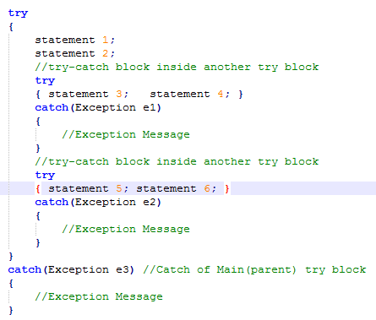
Nested Try Catch
The try block within a try block is known as nested try block in java.

Slide 14
Finally block
The finally block follows a try block or a catch block. A finally block of code always executes, irrespective of occurrence of an Exception.
Using a finally block allows you to run any cleanup-type statements that you want to execute, no matter what happens in the protected code.

Slide 15

Throws/throw
If a method does not handle a checked exception, the method must declare it using the throws keyword. The throws keyword appears at the end of a method's signature.
You can throw an exception, either a newly instantiated one or an exception that you just caught, by using the throw keyword.
A method can declare that it throws more than one exception, in which case the exceptions are declared in a list separated by commas.

Slide 16
Exception Handling with Method Overriding in Java
If the superclass method does not declare an exception
If the superclass method does not declare an exception, subclass overridden method cannot declare the checked exception but it can declare unchecked exception.
If the superclass method declares an exception
If the superclass method declares an exception, subclass overridden method can declare same, subclass exception or no exception but cannot declare parent exception.

Slide 17
Custom Exception
All exceptions must be a child of Throwable.
If you want to write a checked exception that is automatically enforced by the Handle or Declare Rule, you need to extend the Exception class.
If you want to write a runtime exception, you need to extend the RuntimeException class.

Slide 18
Mistakes Java Developers make when Using Exceptions
Using only the Exception class:
It’s a common mistake that developers specifically catch the Exception class for any error.
It’s much more difficult to identify the error if you see only an Exception being caught.
The solution to this problem is to create specific Exceptions – but not too specific!

Slide 19
Mistakes Java Developers make when Using Exceptions(Cont.)
Creating lots of specific Exceptions:
Don’t create Exceptions for everything. Your application will be full of classes, useless repetition and you will create unnecessary work. Instead, create Exceptions for really important business requirements. For example, if you are developing a bank system one possible Exception would be when trying to withdraw money and the balance is zero: BalanceNotAvailableException. Another Exception would be transferring money to another person and the account does not exist, you can create: BankAccountNotFoundException and show an understandable Exception message to the user.
RuntimeException could be used when the bank’s server is out of service. Here you can use, for example: ServerNotAvailableException. The system must crash for this kind of error. There is no recovery.

Slide 20
Mistakes Java Developers make when Using Exceptions(Cont.)
Creating a log for every catch:
Logging every Exception catch will pollute your code. To prevent this, just log once and throw your Exception in the last catch. You won’t lose your Stacktrace if you wrap the Exception. If you are working with web applications, you should create a catch on your controller layer and log the error.

Slide 21

Mistakes Java Developers make when Using Exceptions(Cont.)
Silencing Exceptions:
Never catch the Exception and do nothing, for example:
The catch will be useless. It’s impossible to know what happened and the Exception will be silenced. The developer will be obliged to debug the code and see what happened. If we create a good log, the time-consuming analysis won’t be necessary.

Slide 22
Mistakes Java Developers make when Using Exceptions(Cont.)
Not following the principle “throw early, catch late:
If you have to handle Exception, for example, in your Service, you should do two things:
Wrap your Exception
Throw the Exception to the last catch and handle it.

Slide 23
Mistakes Java Developers make when Using Exceptions(Cont.)
Not following the principle “throw early, catch late:
If you have to handle Exception, for example, in your Service, you should do two things:
Wrap your Exception
Throw the Exception to the last catch and handle it.
Not using clear messages on the Exceptions:
Always use clear messages on your Exceptions. Doing this will help a lot when finding errors. Even better, create a Properties File with all Exception messages. You can use the file on your View layer and show users messages about the business requirements.

Slide 24
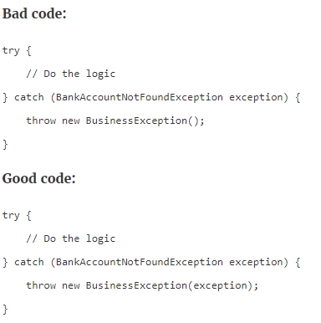
Mistakes Java Developers make when Using Exceptions(Cont.)
Never lose the Stacktrace:
When wrapping an Exception in another one, don’t just throw the other Exception, keep the Stacktrace.

Slide 25
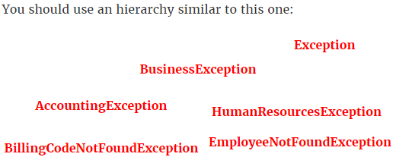
Mistakes Java Developers make when Using Exceptions(Cont.)
Not organizing the hierarchy of specific Exceptions:
If you don’t organize the hierarchy of your Exceptions, the relationship will be difficult between the parts of the system. You will have lots of problems.

Slide 26
References: Effective Java 2nd Edition

Slide 27
THANK YOU

